Slide 1

BASIC COMPUTER USAGE

Slide 2



NOTE TAKING
DURING THE CLASS
AFTER THE CLASS
QUICK NOTES
ON YOUR DRAFT NOTEBOOK
CLEAN NOTES
ON YOUR BCU NOTEBOOK

Slide 3
The course step by step !
What is Windows
What is an application
What a computer is composed of
Use Windows

Slide 4
The course step by step !
Files & folder
What is a file, a folder
How to work with files
What is Windows
What is an application
What a computer is composed of
Use Windows

Slide 5
The course step by step !
What is internet
How to search on internet
How to use Google applications
What is internet?
Files & folder
What is a file, a folder
How to work with files
What is Windows
What is an application
What a computer is composed of
Use Windows

Slide 6
The course step by step !
Computer
Hardware
How computer hardware works ?
What makes a computer run fast ?
What is internet
How to search on internet
How to use Google applications
What is internet?
Files & folder
What is a file, a folder
How to work with files
What is Windows
What is an application
What a computer is composed of
Use Windows

Slide 7
The course step by step !
How to install Windows from a USB boot ?
What is the disk portioning?
How to install a driver?
What to install, uninstall applications ?
Windows
Administration
Computer
Hardware
How computer hardware works ?
What makes a computer run fast ?
What is internet
How to search on internet
How to use Google applications
What is internet?
Files & folder
What is a file, a folder
How to work with files
What is Windows
What is an application
What a computer is composed of
Use Windows

Slide 8
Course Duration
JAN
FEB
MAR
50 hours
Course evaluation
Midterm 30 %
Final 40 %
Quiz 10 %
Participation 10%
Homework 5%
Note taking 5%

Slide 9

BASIC COMPUTER USAGE
BASIC COMPUTER USAGE
CHAPTER 1
WHAT IS A COMPUTER ?

Slide 10

OBJECTIVES FOR TODAY
What is a computer, what is a hardware
How to login and logout on Windows
How to change a password
What are the 5 mouse actions

Slide 11


DISCUSS
05 MIN
What is a computer?
and what does it do ?
TO COMPLETE THIS ACTIVITY :
1
DISCUSS IN TEAM
2
SHARE TO THE CLASS

Slide 12

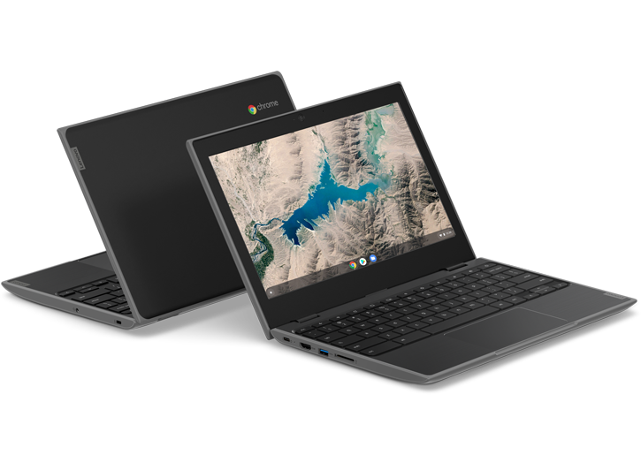

EXPLAIN
05 MIN
CLASS
What is a computer?
A computer is an electronic machine…
…that
performs operations
… A set of operations is a
program
+
/
*
Notes:
The computer is an electronic device that takes input from the user and processes these data under the control of a set of instructions (called program) and gives the result (output) and saves future use.
The computer is an electronic machine that performs processes, calculations, and operations based on instructions provided by a software.
Explain is simple way. Comparing computer to smartphone.
There are two basic component of computer
Hardware
Software
Give example of some task that computer can do:
Learning
Send mail
Play game
…

Slide 13
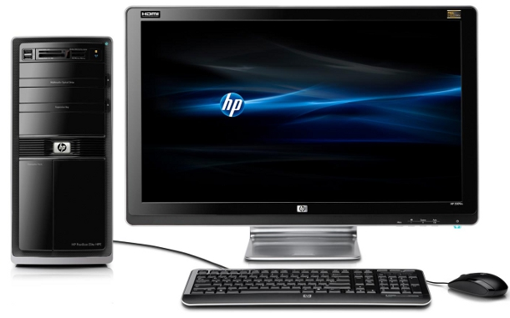
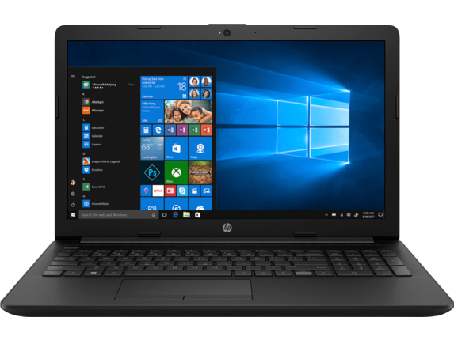
DISCUSS
An hardware is a physical part of a computer
Find the missing name :
1 ?
6 ?
3 ?
2 ?
9 ?
8 ?
7 ?
4 ?
5 ?

Slide 14
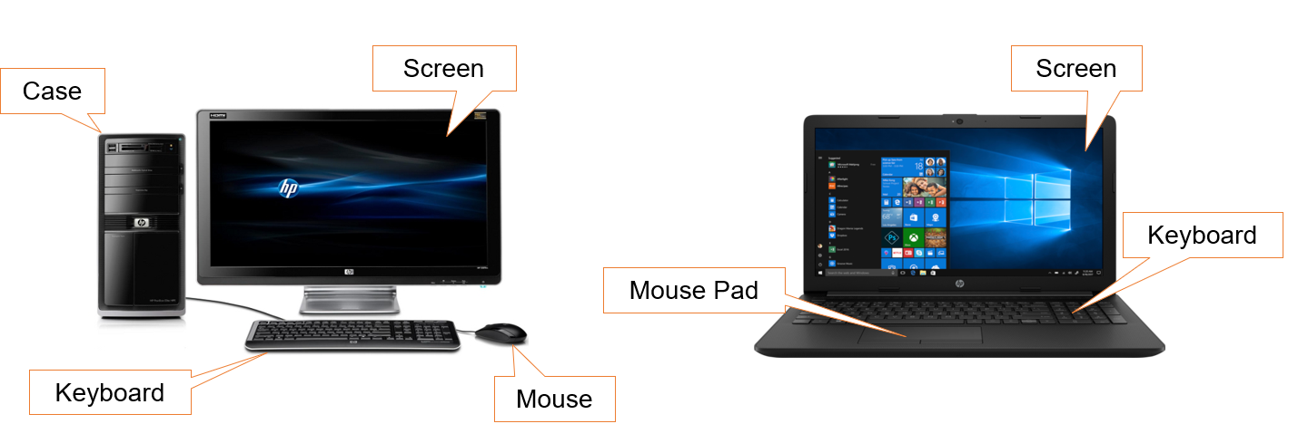
EXPLAIN
An hardware is a physical part of a computer
Desktop
Laptop
Touch Pad
Notes:
Computer hardware:
External Hardware: Mouse, Keyboard, Monitor, and etc.
Internal Hardware (inside the computer / case): RAM, CPU, Mainboard, Hard disk, etc.

Slide 15
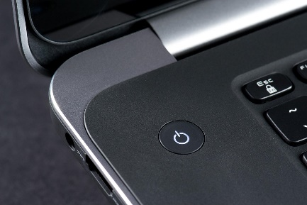
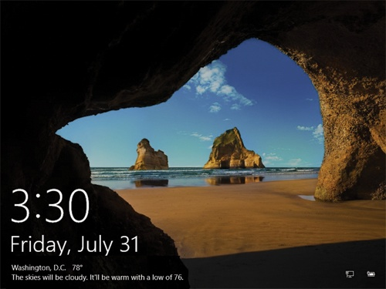
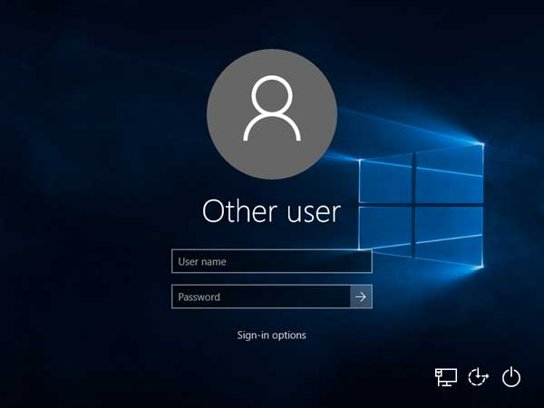

ACTIVITY
Let s start !
1 - Power button
2 – Lock screen
3 – Login screen
Your teacher will provide your
PNC default login/password
Notes:
We can use many options for login, but one general use is username and password.
PIN
Fingerprint
Face recognize
Password
Etc…

Slide 16
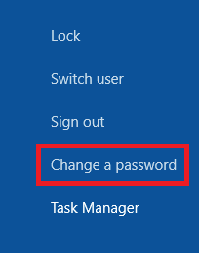

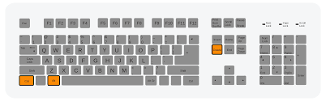
ACTIVITY
Change your password
Enter the magic keys
CTRL + ALT + DEL
Select
Change a password
Change
password
A good password shall contain:
An upper case
A number
At least 6 characters

Slide 17
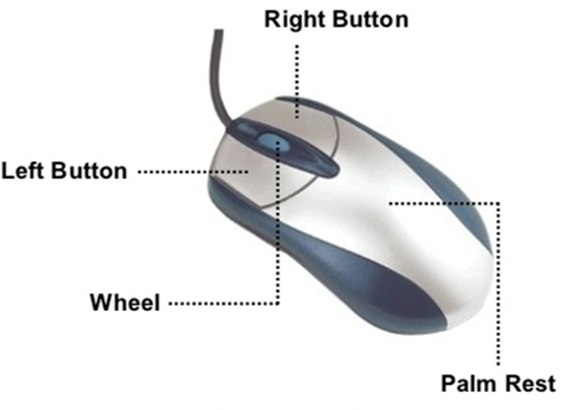
EXPLAIN
A mouse can perform 5 actions
05 MIN
CLASS
ACTION | USAGE
Left Click | Select objects
Right Click | open pop-up menus
Double (left) click | open file, applications
Drag | move the selected object
Scroll | Scroll on a document

Slide 18

ACTIVITY
10 MIN
Let s try !
Chrome icon
Click on Chrome icon on desktop
Drag Chrome icon to another position
Double click on chrome icon to open the application
Right click to open the contextual menu : what do you see ?

Slide 19


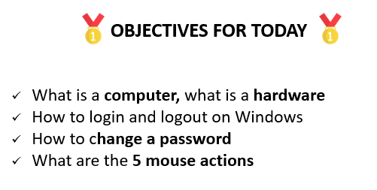
HOMEWORK
For next time
Review the slides send by the teacher
Review your draft notes
Write clean notes on your BCU workbook
Can you answer to the objective question ?
DRAFT NOTES
BCU NOTEBOOK
Take time to transfer your draft note to clean notes
Always make sure you can answer to the objectives

Slide 20
